Slide 1

Unveiling the Spectrum of Rest :
Exploring Seven Transformative Dimensions

Slide 2
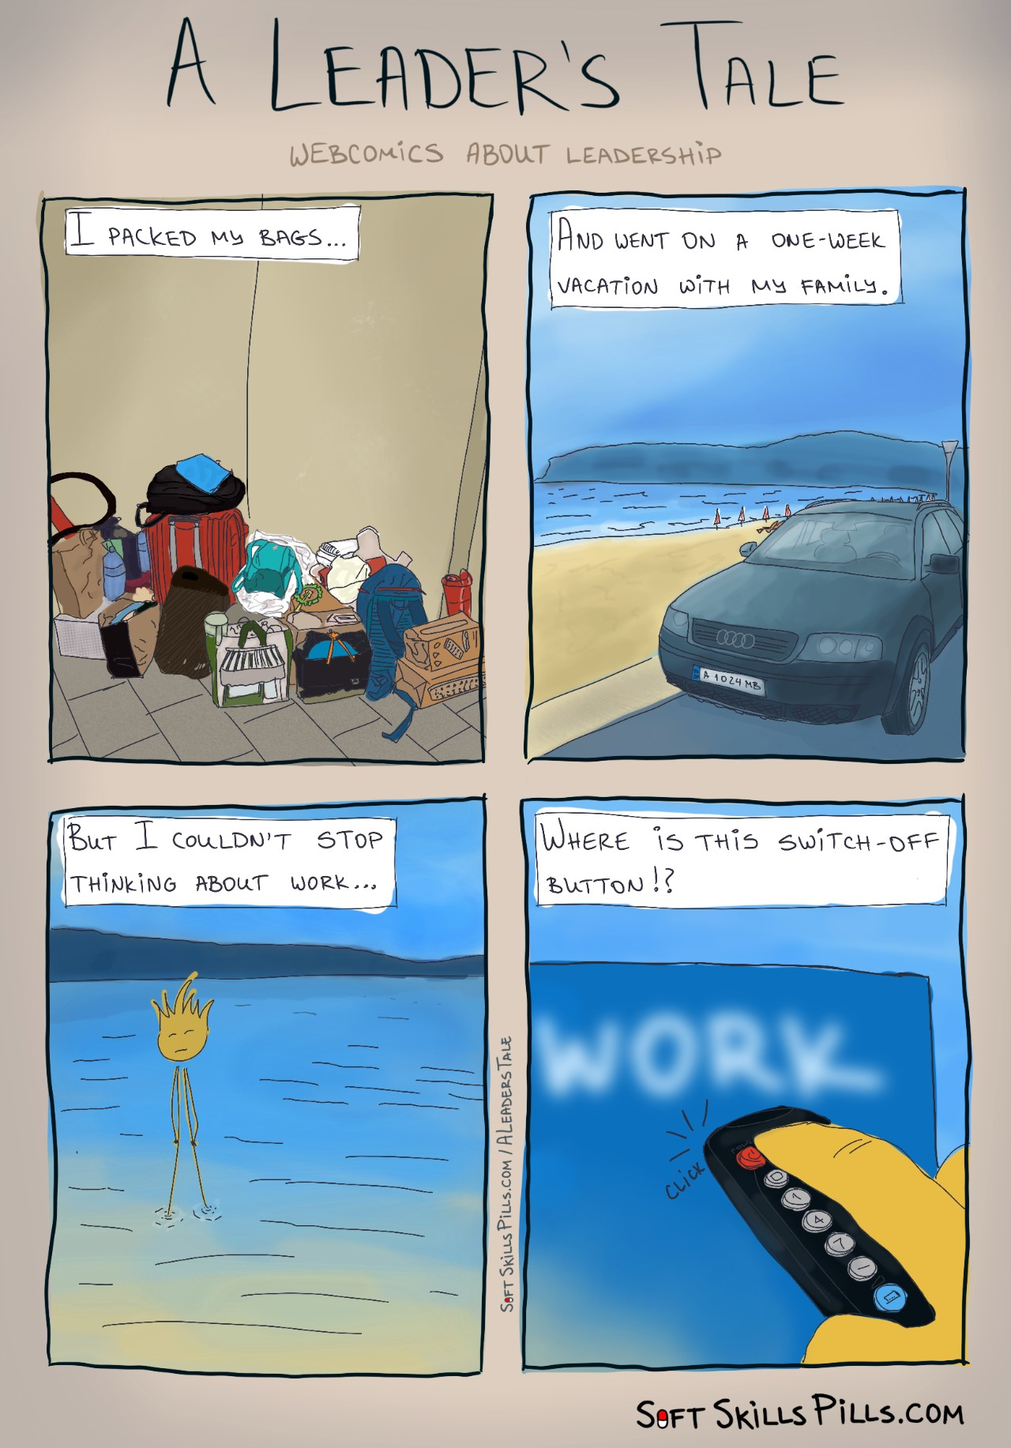

Slide 3
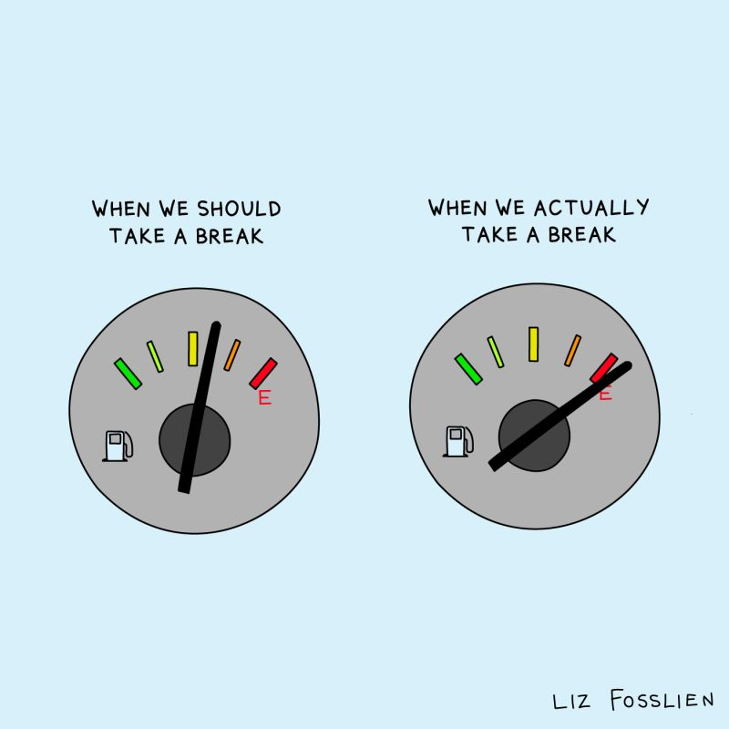
PROACTIVE vs REACTIVE

Slide 4
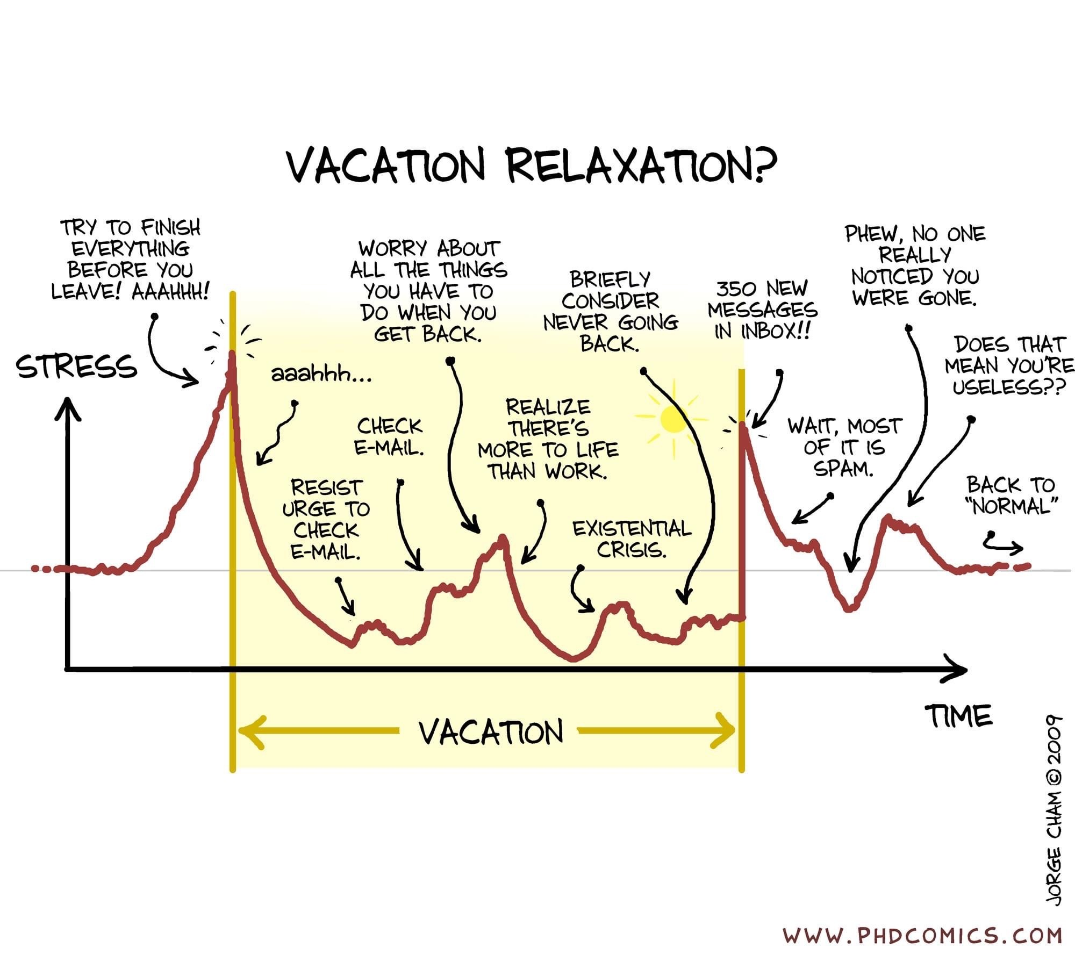

Slide 5
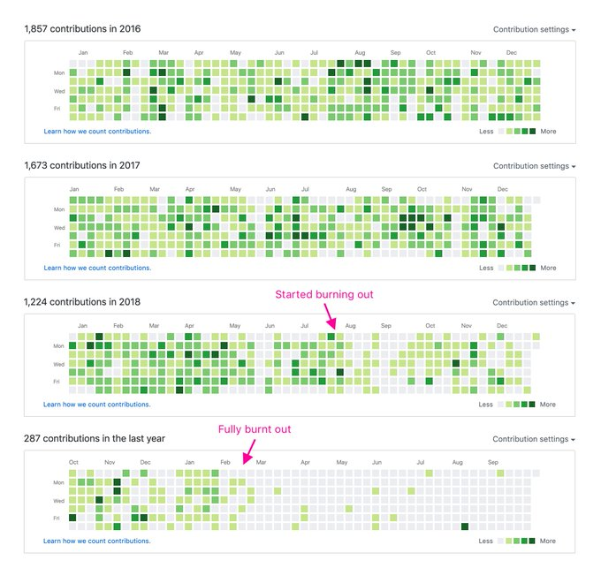
Visualizing burnout.
Credits : Jonnie Hallman

Slide 6
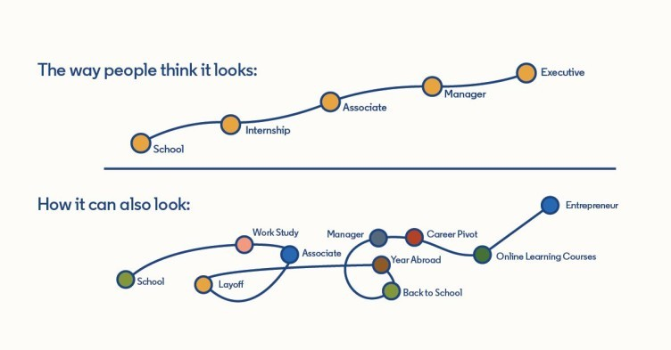

EXPECTATIONS vs REALITY

Slide 7


SLEEP ≠ REST
1/7

Slide 8


REST
Underused
Chemical Free
Safe
Effective
Alternative form of therapy

Slide 9
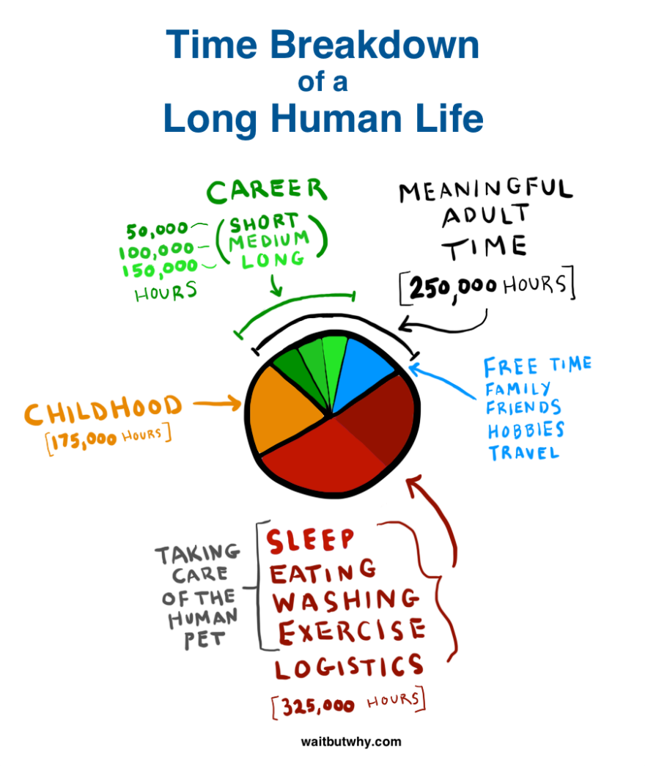

Slide 10



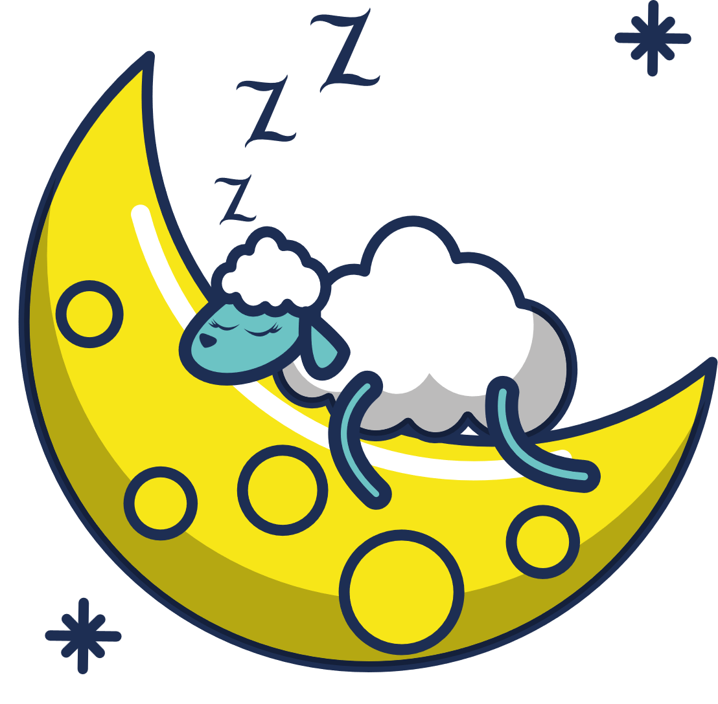



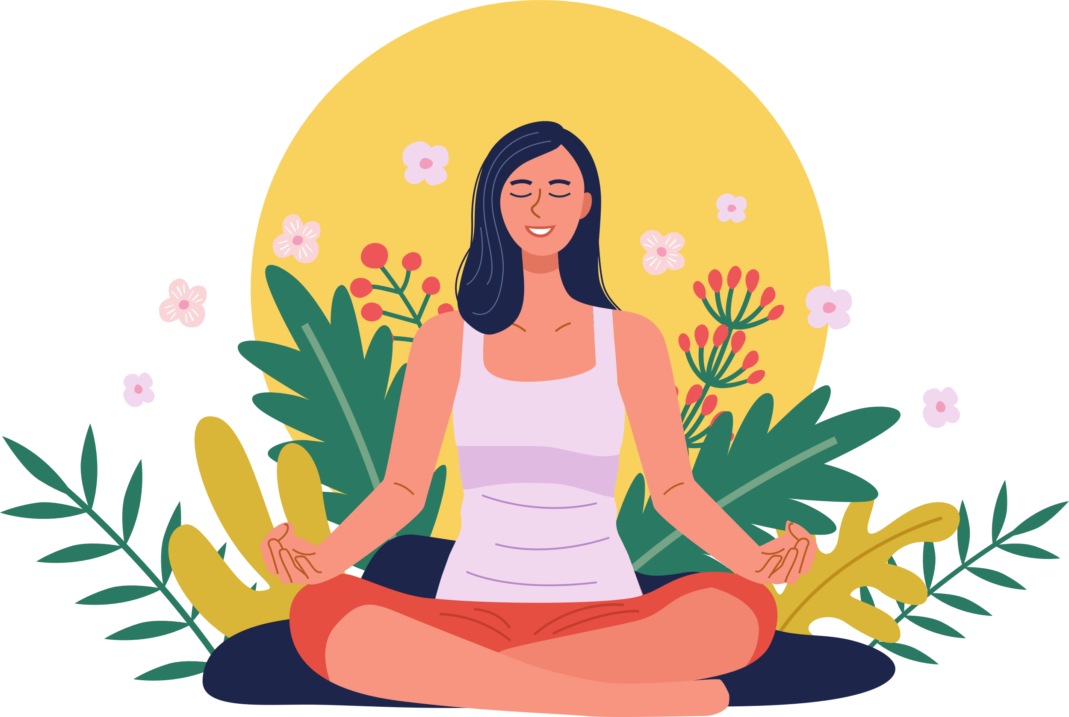





7 types of Rest
Physical Rest
Emotional Rest
Mental Rest
Spiritual Rest
Sensory Rest
Creative Rest
Social Rest

Slide 11

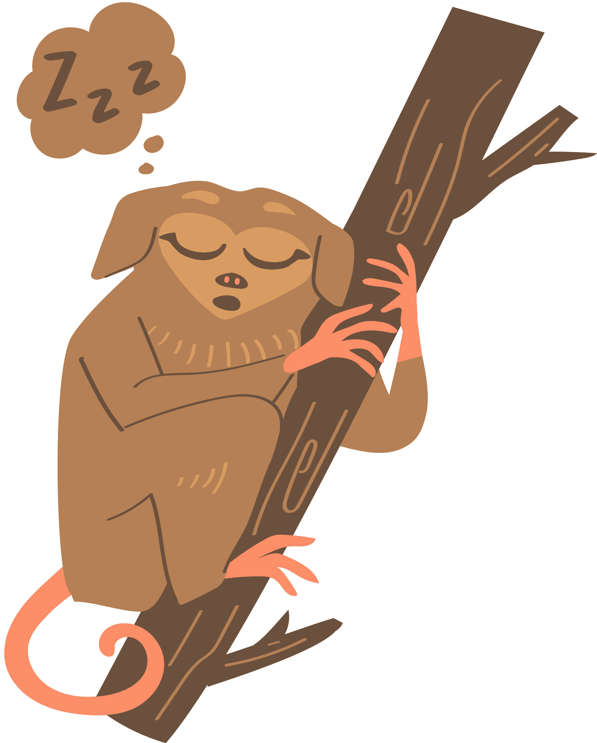

Physical Rest
Lack of sleep and overtraining deplete your body's energy.
Passive
Sleep 7+ hrs. nightly
Take power naps (as needed)
Active
Restorative activities
Massage improve the body’s circulation and flexibility

Slide 12





Mental Rest
Mental rest deficit is caused by overtaxing your thinking.
Create a shutdown ritual to separate work and life
Notepad by the bed for nagging thoughts
Take a break from problem-solving
Brain-breaks (Schedule them. Use Pomodoro)
Music, silence, journaling
Notes:
You might also keep a notepad by the bed to jot down any nagging thoughts that would keep you awake

Slide 13




Emotional Rest
Emotional rest deficit occurs when you feel like you can't be authentic.
Spend time with people you can be authentic around
Try speaking with a therapist to release emotional labor
People pleasing
Notes:
Ex: An airline attendant who must always smile, despite rude passengers.
Truthful no but reluctant yes

Slide 14



Creative Rest
Important for anyone who must solve problems or brainstorm new ideas
Appreciate beauty in any form, whether natural or human-created.
Natural
Take in a sunrise or sunset
Go for a walk in nature
Be childlike and reawaken wonder
Human-created
Visit a museum or art festival
Engage with inspiring music, books, documentaries

Slide 15





Sensory Rest
The modern individual is overstimulated.
Take a break from social media
Turn off notifications (sounds and visual alerts)
Limit video meetings
Set a relaxing evening ambiance (soothing music, candles)
Turn down lights
Digital Detox

Slide 16



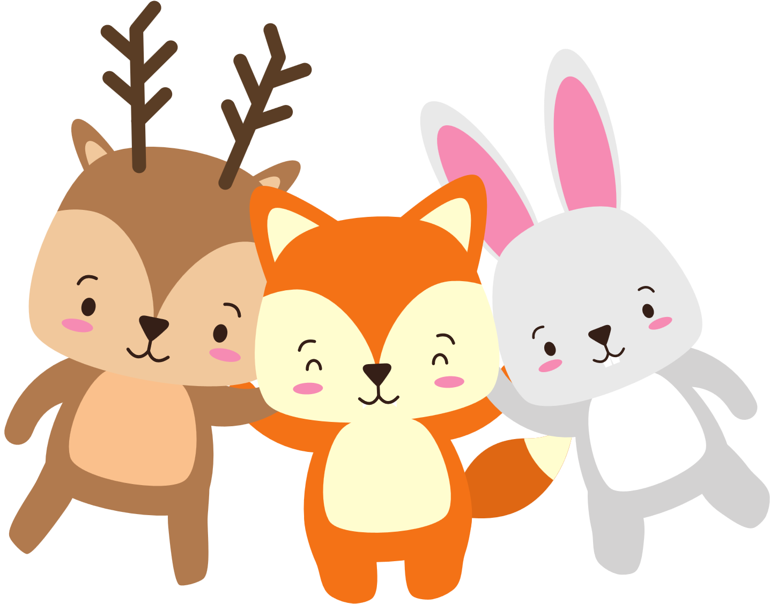
Social Rest
Evaluate your relationships! (Revive or Exhaust?)
Spend more time with people who give you energy and provide support
Spend less time with people who steal your energy
If you're an introvert, block out time to be alone.
Fill your own battery

Slide 17




Spiritual Rest
Ability to connect beyond the physical and mental and feel a deep sense of belonging, love, acceptance and purpose
Do things that provide a meaning.
Be part of something bigger than yourself.
Volunteer
Work a job that feels purpose-driven
Participate in faith-based activities (if aligned to your belief system)

Slide 18

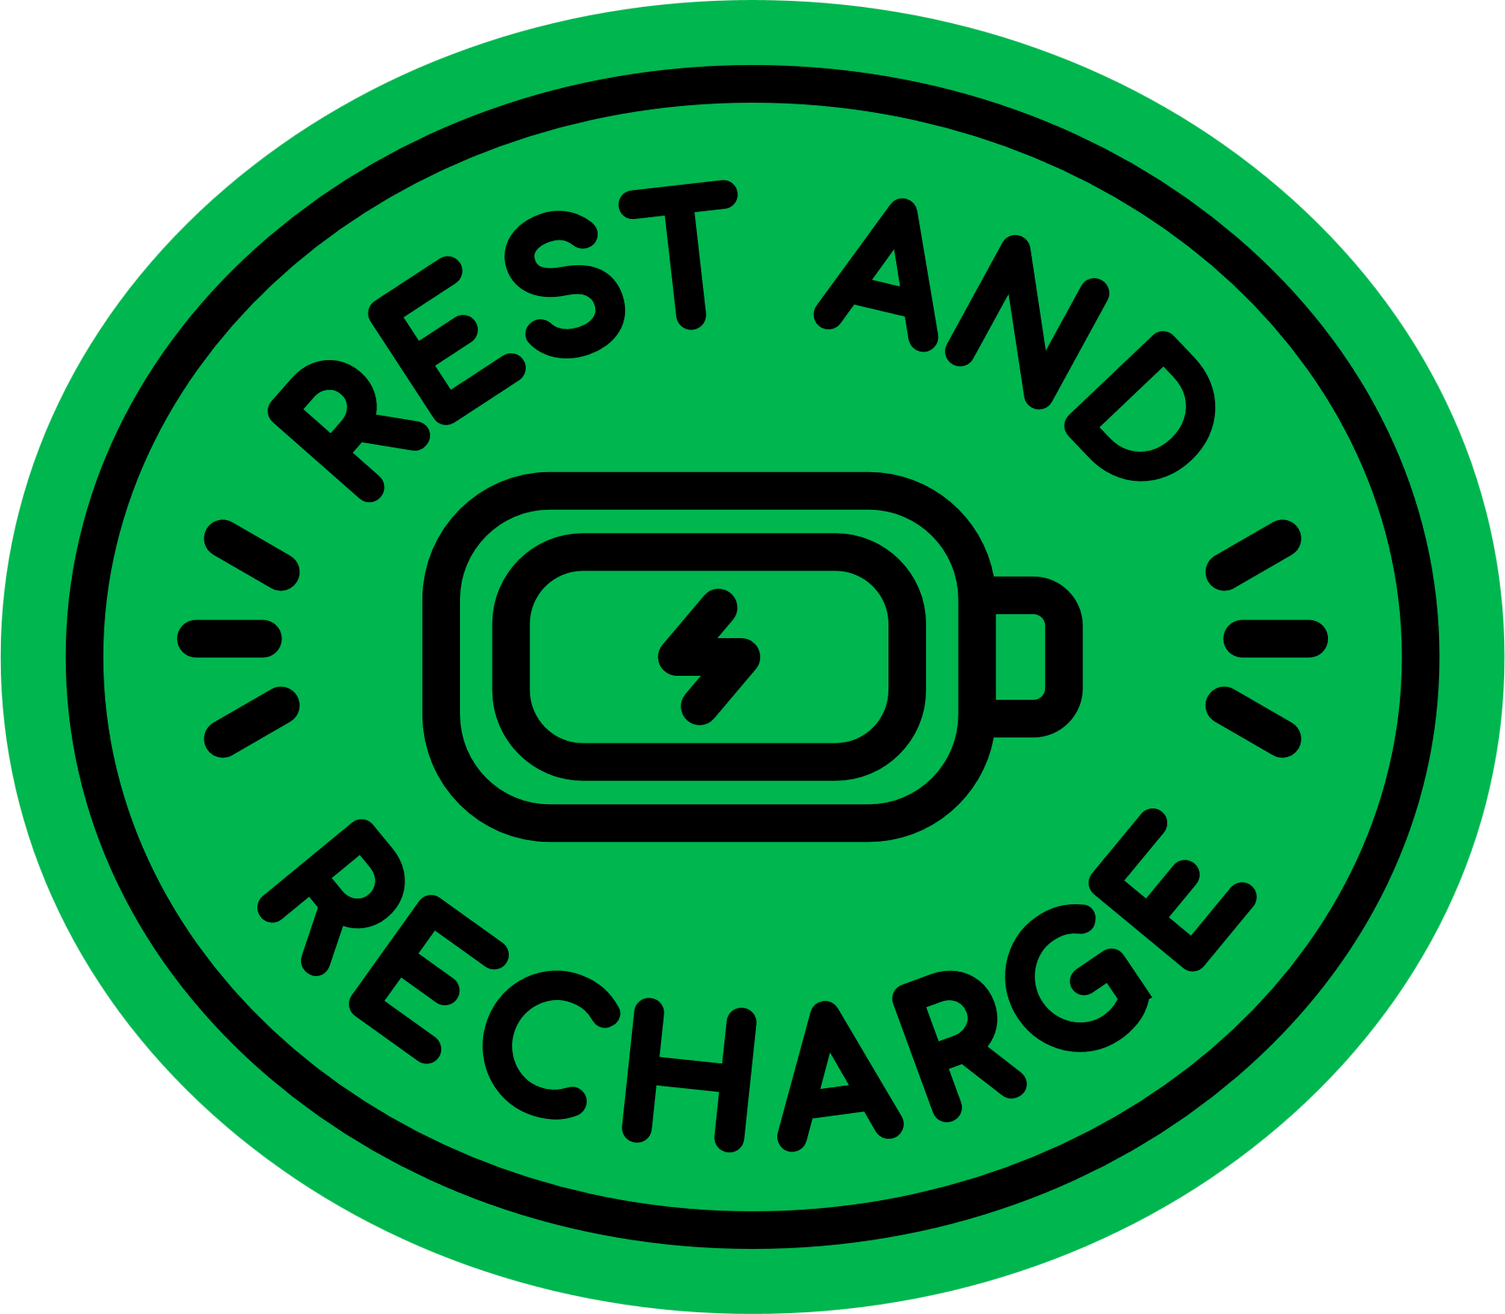


Takeaways
REST = RESTORATION
Dr. Dalton-Smith recommends starting with your 1-2 biggest rest deficits
Don’t try to eat the whole elephant at once
Then, over time, create daily and weekly habits to get all 7 (habit stacking)

Slide 19
Inspiration :Dr. Saundra Dalton-Smith https://www.youtube.com/watch?v=ZGNN4EPJzGk&t=6s
Helping organizations overcome burnout, decrease employee turnover, and cultivate
a well-being culture featuring her proprietary 7 Types of Rest framework.

Slide 20
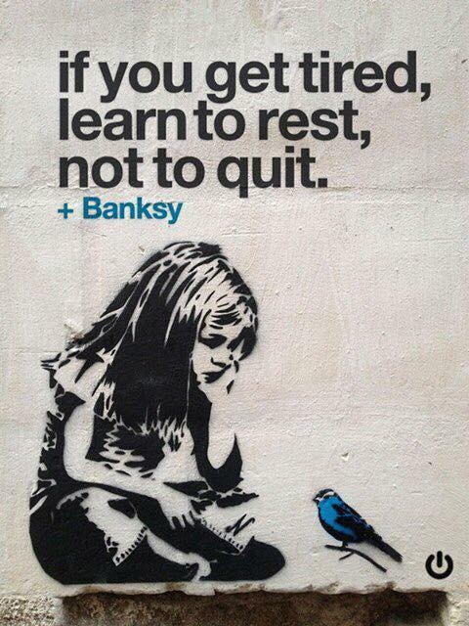

Slide 21
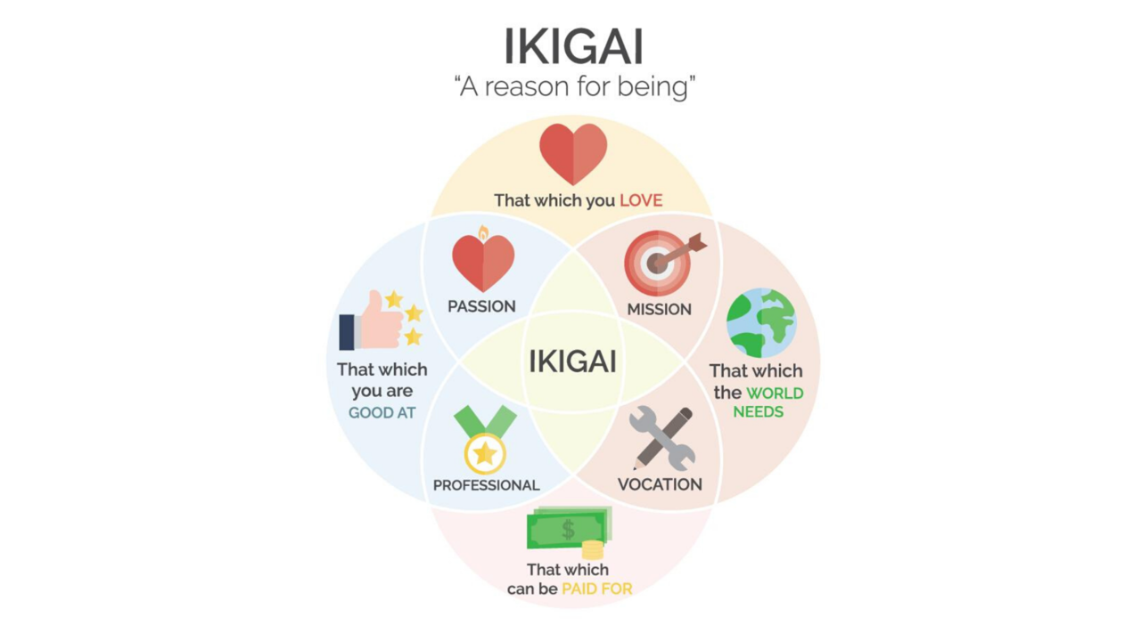
Notes:
If time permits

Slide 22


Thank you
P.S. Fatigue can also be associated with numerous health problems, so please get checked out by your physician if it persists.

Slide 23

QUESTIONS?

Slide 24


Team

